Slide 1
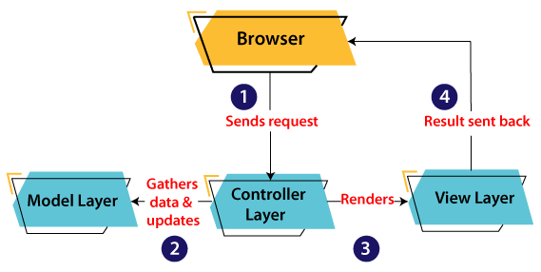

Advance Java
MVC Architecture
The model designs based on the MVC architecture follow MVC design pattern. The application logic is separated from the user interface while designing the software using model designs.
The MVC pattern architecture consists of three layers:

Slide 2
Advance Java
MVC Architecture
Servlet | JSP
Servlet is a java code. | JSP is a HTML-based compilation code.
Writing code for servlet is harder than JSP as it is HTML in java. | JSP is easy to code as it is java in HTML.
Servlet is faster than JSP. | JSP is slower than Servlet because the first step in the JSP lifecycle is the translation of JSP to java code and then compile.
Servlet can accept all protocol requests. | JSP only accepts HTTP requests.
Modification in Servlet is a time-consuming compiling task because it includes reloading, recompiling, JavaBeans and restarting the server. | JSP modification is fast, just need to click the refresh button.

Slide 3
Advance Java
Hibernate
Hibernate is a Java framework that simplifies the development of Java application to interact with the database.
Advantages of Hibernate Framework
1) Open Source and Lightweight
2) Fast Performance
First level cache is enabled by default.
3) Database Independent Query
HQL (Hibernate Query Language) is the object-oriented version of SQL. It generates the database independent queries. So you don't need to write database specific queries.
4) Automatic Table Creation
Hibernate framework provides the facility to create the tables of the database automatically.
5) Simplifies Complex Join
Fetching data from multiple tables is easy in hibernate framework.

Slide 4
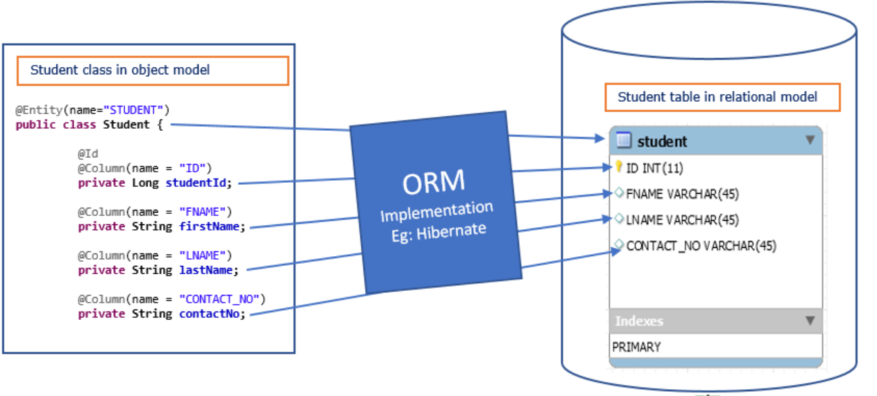
Advance Java
ORM Tool
An ORM tool simplifies the data creation, data manipulation and data access. It is a programming technique that maps the object to the data stored in the database.

Slide 5
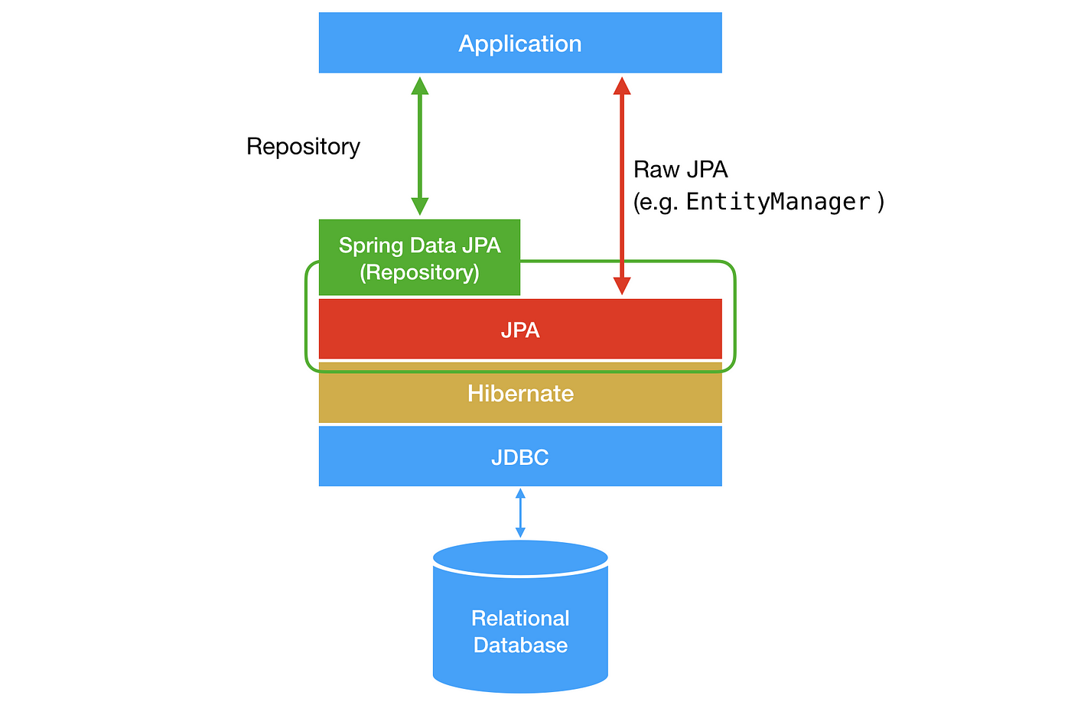
Advance Java
What is JPA?
Java Persistence API (JPA) is a Java specification that provides certain functionality and standard to ORM tools. The javax.persistence package contains the JPA classes and interfaces.

Slide 6
Advance Java
Hibernate – Annotations
Annotations | Use of annotations
@Entity | Used for declaring any POJO class as an entity for a database
@Table | Used to change table details, some of the attributes are-
@Id | Used for declaring a primary key inside our POJO class
@GeneratedValue | Hibernate automatically generate the values with reference to the internal sequence and we don’t need to set the values manually.
@Column | It is used to specify column mappings. Name – We can change the name of the entity for the database length – the size of the column mostly used in strings unique – the column is marked for containing only unique values nullable – The column values should not be null. It’s marked as NOT
@Transient | Tells the hibernate, not to add this particular column

Slide 7
Advance Java
Hibernate Example using XML in Eclipse
<session-factory>
<property name="hbm2ddl.auto">update</property>
<property name="dialect">org.hibernate.dialect.mysql5Dialect</property>
<property name="connection.url">jdbc:mysql:@localhost:3306:xe</property>
<property name="connection.username">root</property>
<property name="connection.password">root</property>
<property name="connection.driver_class">com.mysql.cj.jdbc.driver</property>
<mapping resource="employee.hbm.xml"/>
</session-factory>

Slide 8
Advance Java
Hibernate Example using Annotation in Eclipse
The hibernate application can be created with annotation.
There are many annotations that can be used to create hibernate application such as @Entity, @Id, @Table etc.
Hibernate Annotations are based on the JPA 2 specification and supports all the features.
All the JPA annotations are defined in the javax.persistence package.
The core advantage of using hibernate annotation is that you don't need to create mapping (hbm) file. Here, hibernate annotations are used to provide the meta data.

Slide 9
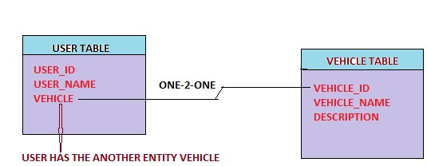
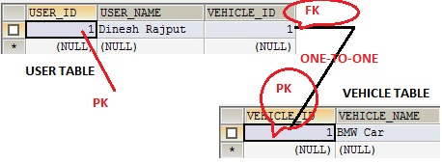
Advance Java
Hibernate One to One Mapping

Slide 10
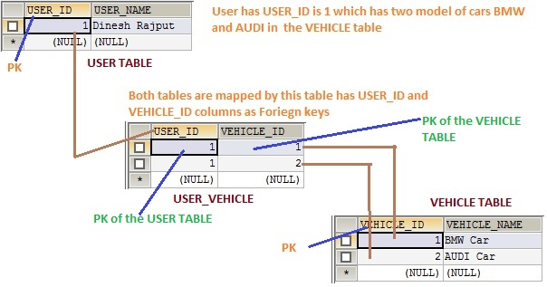
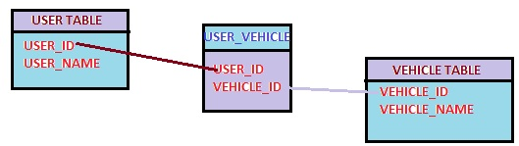
Advance Java
Hibernate One to Many Mapping

Slide 11
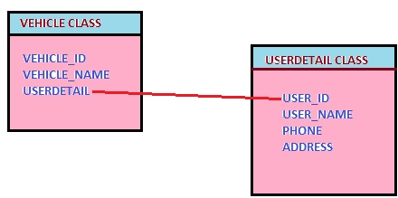
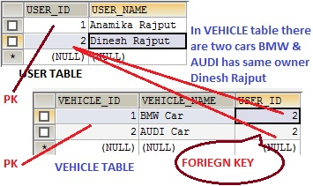
Advance Java
Hibernate Many to One Mapping

Slide 12
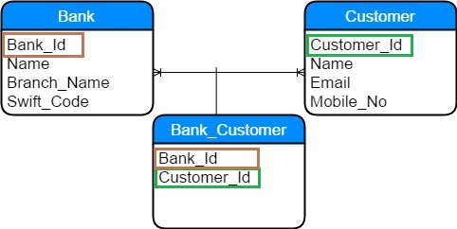
Advance Java
Hibernate Many to Many Mapping

Slide 13
Advance Java
Spring framework
It is an open source Java platform that provides comprehensive infrastructure support for developing robust Java applications very easily and very rapidly.
Why to Learn Spring?
Spring is the most popular application development framework for enterprise Java.
Spring Framework to create high performing, easily testable, and reusable code.
Spring framework is an open source Java platform.
Spring is lightweight when it comes to size and transparency.

Slide 14
Advance Java
Applications of Spring
POJO Based - Spring enables developers to develop enterprise-class applications using POJOs.
Testability - Testing an application written with Spring is simple because environment-dependent code is moved into this framework.
Web MVC - Spring's web framework is a well-designed
Central Exception Handling - Spring provides a convenient API to translate technology-specific exceptions (thrown by JDBC, Hibernate, or JDO, for example).
Lightweight - This is beneficial for developing and deploying applications on computers with limited memory and CPU resources.
Transaction management - Spring provides a consistent transaction management interface that can scale down to a local transaction (using a single database, for example).

Slide 15
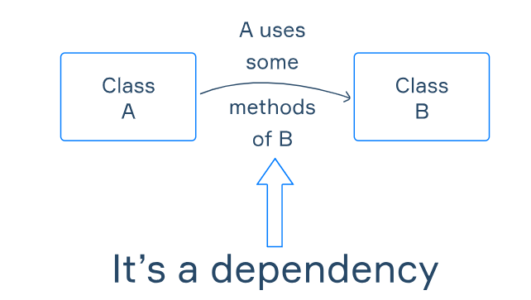
Advance Java
Dependency Injection in Spring
Dependency Injection (DI) is a design pattern that removes the dependency from the programming code so that it can be easy to manage and test the application.
Dependency Injection makes our programming code loosely coupled.

Slide 16
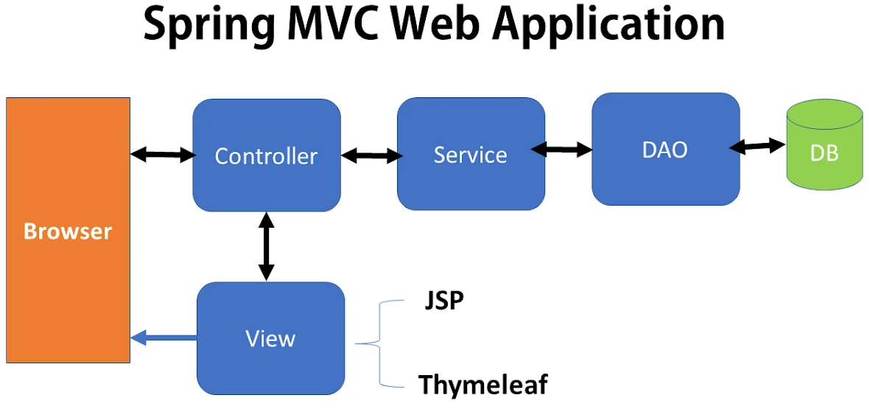
Advance Java
Spring MVC

Slide 17
Advance Java
Spring MVC Validation
The Spring MVC Validation is used to restrict the input provided by the user.
To validate the user's input, the Spring 4 or higher version supports and use Bean Validation API.
It can validate both server-side as well as client-side applications.
Types of validations,
1. Regular Expression Validation
2. Custom Validation
3. Number Validation

Slide 18
Advance Java
Spring MVC Validation
The Spring MVC Validation is used to restrict the input provided by the user.
To validate the user's input, the Spring 4 or higher version supports and use Bean Validation API.
It can validate both server-side as well as client-side applications.
Types of validations,
1. Regular Expression Validation
2. Custom Validation
3. Number Validation

Slide 19
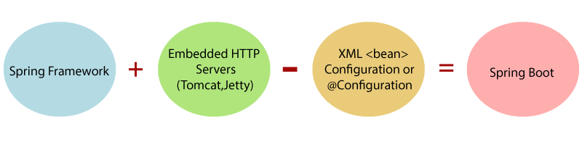
Advance Java
Spring Boot Framework
It is a Spring module that provides the RAD (Rapid Application Development) feature to the Spring Framework.
It is used to create a stand-alone Spring-based application that you can just run because it needs minimal Spring configuration.
In short, Spring Boot is the combination of Spring Framework and Embedded Servers.
In Spring Boot, there is no requirement for XML configuration (deployment descriptor).

Slide 20
Advance Java
Advantages of Spring Boot
It tests web applications easily with the help of different Embedded HTTP servers such as Tomcat, Jetty, etc. We don't need to deploy WAR files.
It provides opinionated 'starter' POMs to simplify our Maven configuration.
There is no requirement for XML configuration.
It offers the number of plug-ins.
It also minimizes writing multiple boilerplate codes (the code that has to be included in many places with little or no alteration), XML configuration, and annotations.
It increases productivity and reduces development time.

Slide 21
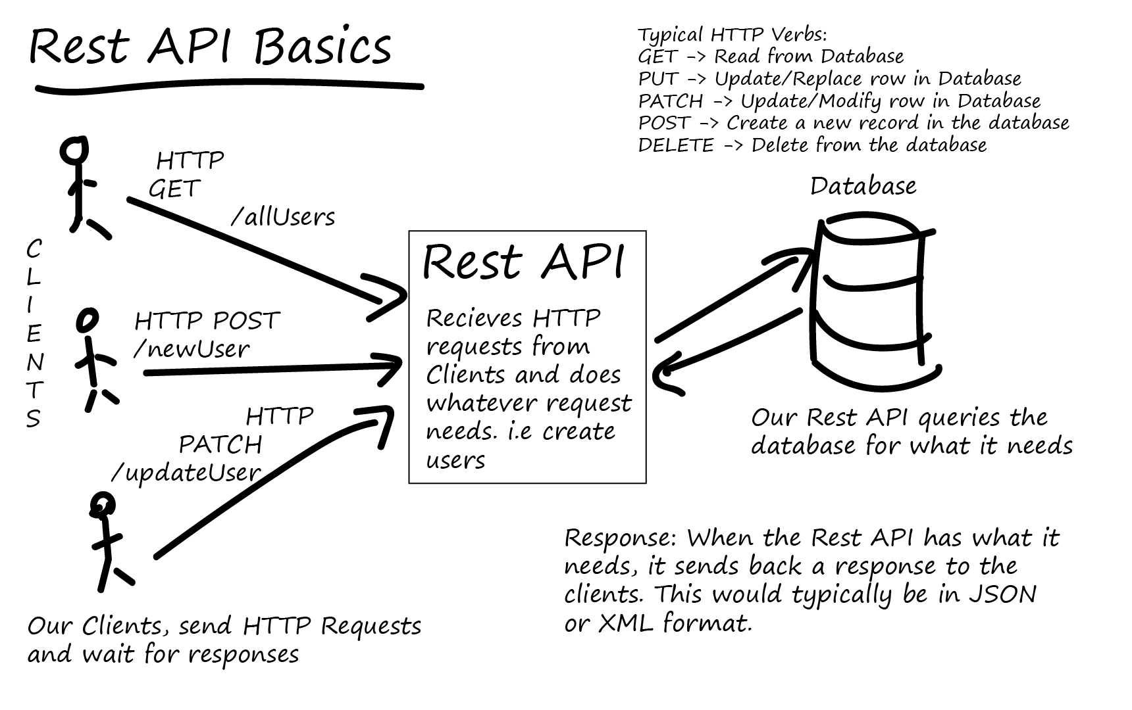
Advance Java

Slide 22
Advance Java
Spring Boot – Annotations
Annotations | Use of annotations
@Controller | It marks a class as a web request handler.
@Repository | The repository is a DAOs (Data Access Object) that access the database directly.
@SpringBootApplication | It is a combination of three annotations @EnableAutoConfiguration, @ComponentScan, and @Configuration.
@GetMapping | It maps the HTTP GET requests on the specific handler method.
@PostMapping | It maps the HTTP POST requests on the specific handler method.
@PutMapping | It maps the HTTP PUT requests on the specific handler method.
@DeleteMapping | It maps the HTTP DELETE requests on the specific handler method.
@RestController | It can be considered as a combination of @Controller and @ResponseBody annotations.

Slide 23
Advance Java
Spring Boot – Annotations
Annotations | Use of annotations
@Controller | It marks a class as a web request handler.
@Repository | The repository is a DAOs (Data Access Object) that access the database directly.
@SpringBootApplication | It is a combination of three annotations @EnableAutoConfiguration, @ComponentScan, and @Configuration.
@GetMapping | It maps the HTTP GET requests on the specific handler method.
@PostMapping | It maps the HTTP POST requests on the specific handler method.
@PutMapping | It maps the HTTP PUT requests on the specific handler method.
@DeleteMapping | It maps the HTTP DELETE requests on the specific handler method.
@RestController | It can be considered as a combination of @Controller and @ResponseBody annotations.

Slide 24
Advance Java
Thank You
MySQL

